Slide 1


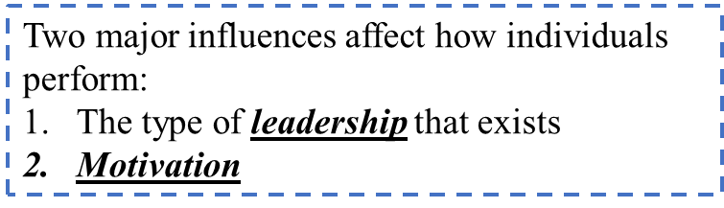
PRINCIPLES OF LEADERSHIP INTRODUCTION
SPRING 2023
LECTURE 01
06 FEBRUARY 2023
FAREED QURESHI

Slide 2

INTRODUCTION
The Common Factor
You
Myself
We

Slide 3
Questions about the Common Factor
What ?
What is Leadership?

Slide 4
LEADERSHIP
رہنمائی
Leadership →
Continuous/dynamic process
Influencing behavior
Context → mutual relations between a leader and his/her followers
Relational process → interactions among leaders, members and sometimes outside constituencies
Point of discussion
“Leaders are made, not born.” What do you think ?
قیادت

Slide 5

A FEW DEFINITIONS
The ability to awaken the desire to follow a common objective – Livingston
The quality of behavior of the individual whereby they guide people or their activities in organized manner – C. I. Bernard
The process of influencing and supporting others to work enthusiastically towards achieving objectives – Bernard Keys & Thomas
A relationship in which one person influences others to work together willingly on related tasks to attain what the leader desires – George Terry
The ability to secure desirable actions from a group of followers voluntarily without the use of coercion – Alford & Beattey

Slide 6
Questions about the Common Factor
What is ….. ?
What is Leadership?
Why is it important ?

Slide 7
WHY IS STUDYING LEADERSHIP IMPORTANT?
Ensures you use the most effective leadership style
It will help you clarify your vision
It will improve your career prospects
Empowers you to succeed
It will boost your confidence
It will teach you new, valuable skill
Helps you communicate better
Develop Better Emotional Intelligence
Teaches you how to influence people
Teaches you how to avoid mistakes

Slide 8
Questions about the Common Factor
What is ….. ?
What is Leadership?
Why is it important ?
How are we going to go about it?
The Contract

Slide 9
EVOLUTION OF LEADERSHIP CONCEPT
1900 – 1929: “the ability to impress the will of the leader on those led and induce obedience, respect, loyalty, and cooperation” (Moore, 1927, p. 124).
1930s: traits became the focus of defining leadership, with an emerging view of leadership as influence rather than domination.
1940s: the behavior of an individual while involved in directing group activities (Hemphill, 1949).
1950s: what leaders do in groups, a relationship that develops shared goals, which defined leadership based on behavior of the leader, and effectiveness, in which leadership was defined by the ability to influence overall group effectiveness
1960s: “acts by persons which influence other persons in a shared direction” (Seeman, 1960)
1970s: “Leadership is the reciprocal process of mobilizing by persons with certain motives and values, various economic, political, and other resources, in a context of competition and conflict, in order to realize goals independently or mutually held by both leaders and followers” (Burns, 1978)
1980s: Noncoercive influence, traits, transformation
From the 1990s into the 21st Century: Authentic, spiritual, servant, adaptive, followership, discursive leadership

Slide 10
TRAIT VERSUS PROCESS LEADERSHIP
Trait Definition Process Definition

Slide 11
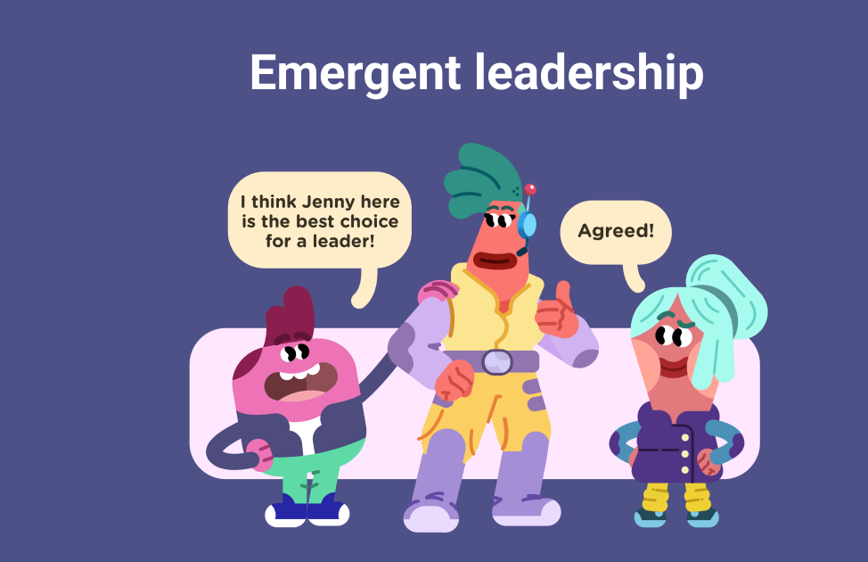
ASSIGNED VERSUS EMERGENT LEADERSHIP

Slide 12
LEADERSHIP AND POWER
Referent Power | Followers’ identification and liking for the leader
Expert Power | Followers’ perceptions of leader’s competence
Legitimate Power | Associated with having status or formal job authority
Reward Power | Derived from having the capacity to provide rewards to others
Coercive Power | Derived from having the capacity to penalize or punish others
Information Power | Derived from possessing knowledge that others want or need.
Position Power
Legitimate
Reward
Coercive
Information
Personal Power
Referent power
Expert power

Slide 13
LEADERSHIP AND COERCION
Coercion → جبر
Use of force to effect change
Influence others to do something against their will
Use of threats, punishment, and negative rewards
Dark side of leadership

Slide 14
LEADERSHIP AND MANAGEMENT
MANAGEMENT PRODUCES ORDER AND CONSISTENCY | LEADERSHIP PRODUCES CHANGE AND MOVEMENT
PLANNING AND BUDGETING | ESTABLISHING DIRECTION
Establish agendas | Create a vision
Set timetables | Clarify big picture
Allocate resources | Set strategies
ORGANIZING AND STAFFING | ALIGNING PEOPLE
Provide structure | Communicate goals
Make job placements | Seek commitment
Establish rules and procedures | Build teams and coalitions
CONTROLLING AND PROBLEM SOLVING | MOTIVATING AND INSPIRING
Develop incentives | Inspire and energize
Generate creative solutions | Empower followers
Take corrective actions | Satisfy unmet needs

Slide 15
THAT IS ALL FOR TODAY !!

